Slide 1
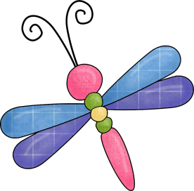
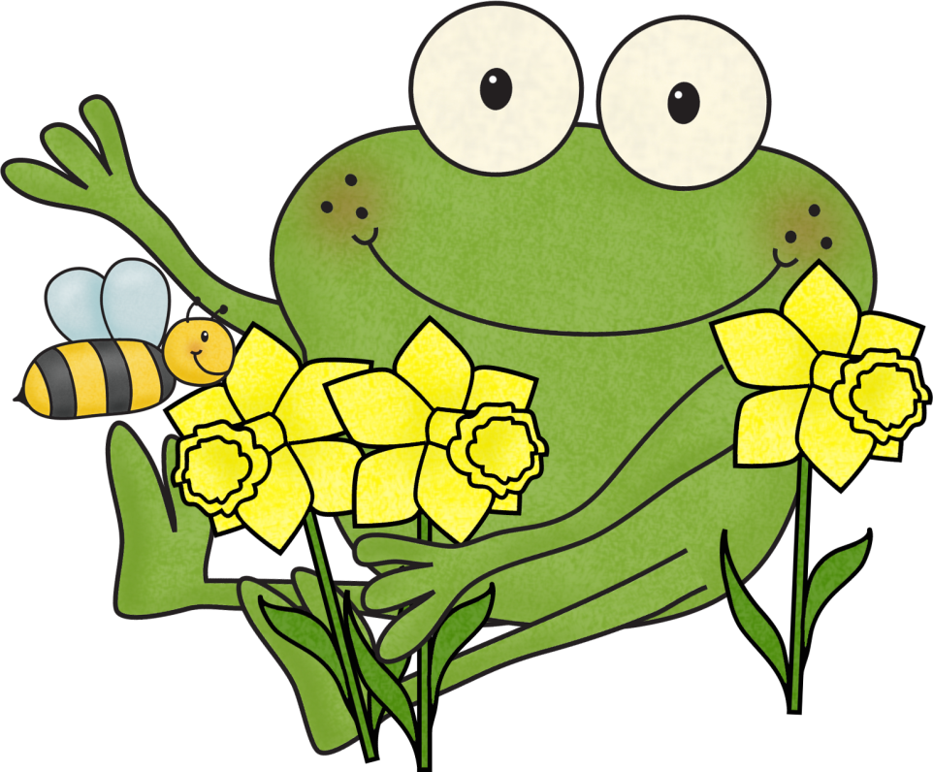
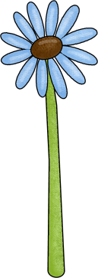
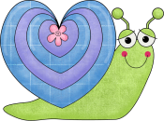
Editing Skills
Leanne Williamson, 2015

Slide 2
The echidna
the echidna also called the anteater, belongs to a special group of mammals called monotremes echidnas have hair and spikes on their body they have big, strong claws for digging echidnas live in thick forests echidnas grow to be about 40 centimetres long they weigh about 8 kilograms the echidna has a snout and a long sticky tongue which is uses to catch ants and termites
A sentence begins with a capital letter and ends with a full stop.
Use your editing skills to find the 6 missing capital letters and 6 full stops.
Rewrite this passage correctly in your work book.
Leanne Williamson, 2015

Slide 3
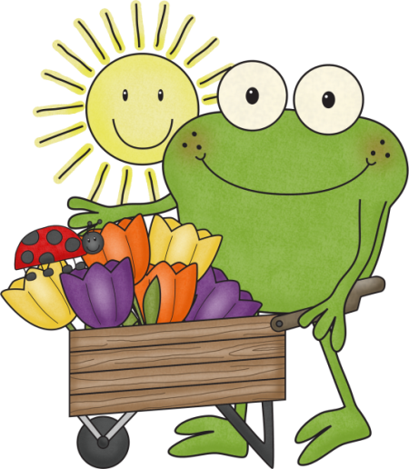
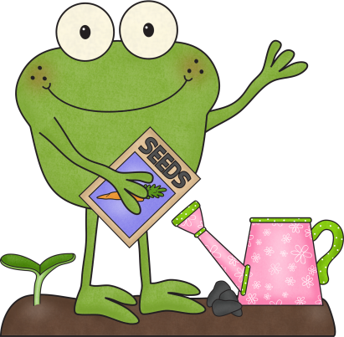
How plants grow
when seeds are planted, they first grow roots once these roots take hold, a small plant will begin to emerge and eventually break through the soil when this happens, we say that the seed has sprouted in order for seeds to grow into plants, they need soil containing nutrients, water, sunlight, the right temperature, room to grow, and time
A sentence begins with a capital letter and ends with a full stop.
Use your editing skills to find the 4 missing capital letters and 4 full stops.
Rewrite this passage correctly in your work book.
Leanne Williamson, 2015

Slide 4
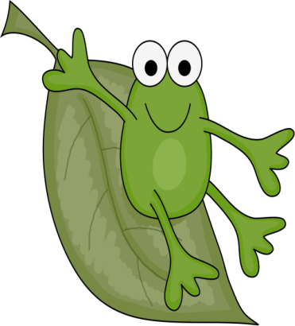
Steph’s dance report
Steph is a polite student who always does her best she always follows the class rules and listens well when her teacher is speaking sometimes she finds it hard to move in time to the music although she is getting better at this every day steph’s arm movements are very good next year, she will need to work on coordinating her whole body movements
well done steph! keep trying hard
The names of people are proper nouns. Proper nouns begin with a capital letter
Use your editing skills to find the 9 missing capital letters for the beginning of sentences and proper noun and 7 full stops.
Rewrite this passage correctly in your work book.
Leanne Williamson, 2015

Slide 5
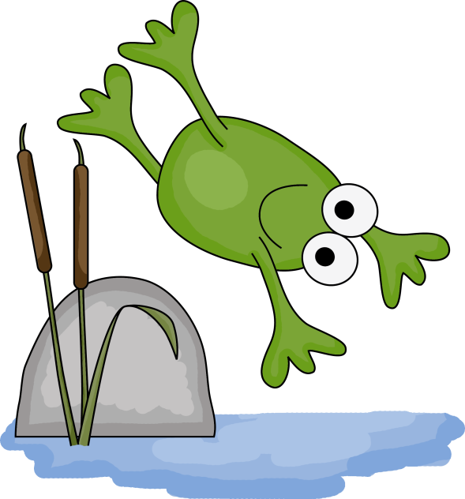
The blue whale
a blue whale is the largest animal on earth a blue whale can grow to about the size of a large dinosaur they can dive very deep in the ocean blue whales can hold their breathe for a very long time in the water their skin looks blue, but it is pale grey
The names of people are proper nouns. Proper nouns begin with a capital letter
Use your editing skills to find the 5 missing capital letters for the beginning of sentences, 1 proper noun and 5 full stops.
Rewrite this passage correctly in your work book.
Leanne Williamson, 2015

Slide 6
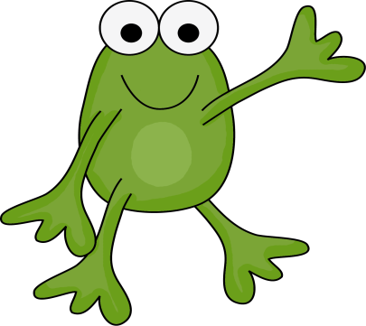
Leanne’s birthday
leanne wanted a pony for her birthday she had seen the one she wanted at the local farm she showed the pony to her mother “the yard is too small for a pony”, mum said leanne was sad on her birthday, leanne woke up early there was a big box on her bed mum and dad came into her room “Happy Birthday!” they said “We know you wanted a pony but we think you will like what you have just as much.” leanne opened the box and out jumped a little puppy leanne was very happy!
The names of people are proper nouns. Proper nouns begin with a capital letter
Use your editing skills to find the 15 missing capital letters for the beginning of sentences and proper noun and 11 full stops.
Rewrite this passage correctly in your work book.
Leanne Williamson, 2015

Slide 7
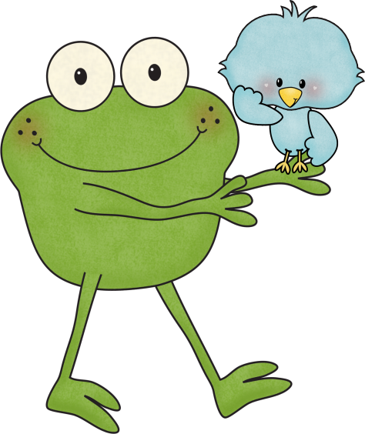
The Blue Mountains
the blue mountains are a mountainous region in new south wales
they are part of the great dividing range which runs from queensland, through new south wales and the australian capital territory into victoria
the blue mountains are located 60 kilometres west of sydney
The names of people are proper nouns. Proper nouns begin with a capital letter
Use your editing skills to find the 22 missing capital letters and 3 full stops.
Rewrite this passage correctly in your work book.
Leanne Williamson, 2015

Slide 8
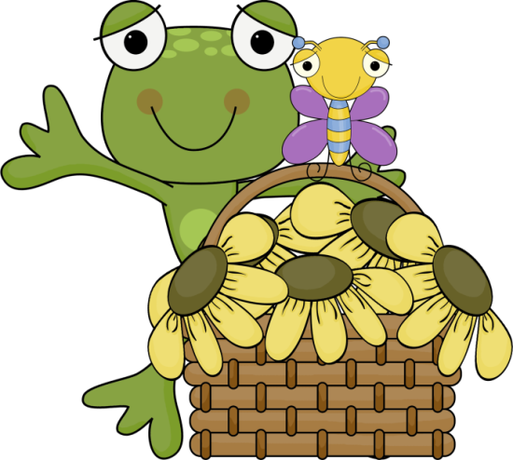
Sun protection is important!
it is important to protect yourself from the sun! spending too much time outdoors in the sun can cause skin cancer thousands of people in australia die from skin cancer each year suspicious spots on your skin may need to be cut out by the doctor getting sunburnt hurts! so it is important to protect yourself from the sun by, slipping on a T-shirt, slopping on some sunscreen and slapping on a hat
The names of people are proper nouns. Proper nouns begin with a capital letter
Use your editing skills to find the 6 missing capital letters and 5 full stops. One word is a special proper noun and also needs a capital letter
Rewrite this passage correctly in your work book.

Slide 9
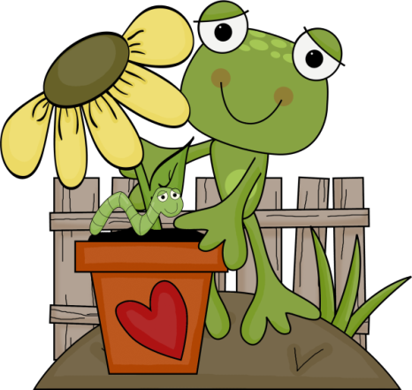
Frogs
frogs are amphibians this means they live part of their life in water and part of it on land frogs have long sticky tongues that flip out fast to help them catch their food they eat worms fish and insects frogs have different ways of shielding themselves against predators some are poisonous and some have brightly colours as a warning some puff up to look bigger. most use camouflage as a way to protect themselves
Commas are usually placed between words in a list.
Use your editing skills to find the 7 missing capital letters, 7 full stops and 1 commas.
Rewrite this passage correctly in your work book.

Slide 10
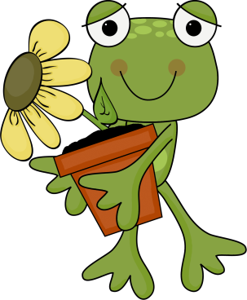
Australia
australia is the sixth largest country in the world it is the only continent that is not divided into more than one country as australia is such a big country it is divided into large sections called states and territories
australia’s capital city is canberra there are cities in all of the states and territories each state and territory has its own capital city
The names of people are proper nouns. Proper nouns begin with a capital letter
Use your editing skills to find the 4 missing capital letters for the beginning of sentences, 4 proper noun and 6 full stops.
Rewrite this passage correctly in your work book.
Leanne Williamson, 2015

Slide 11
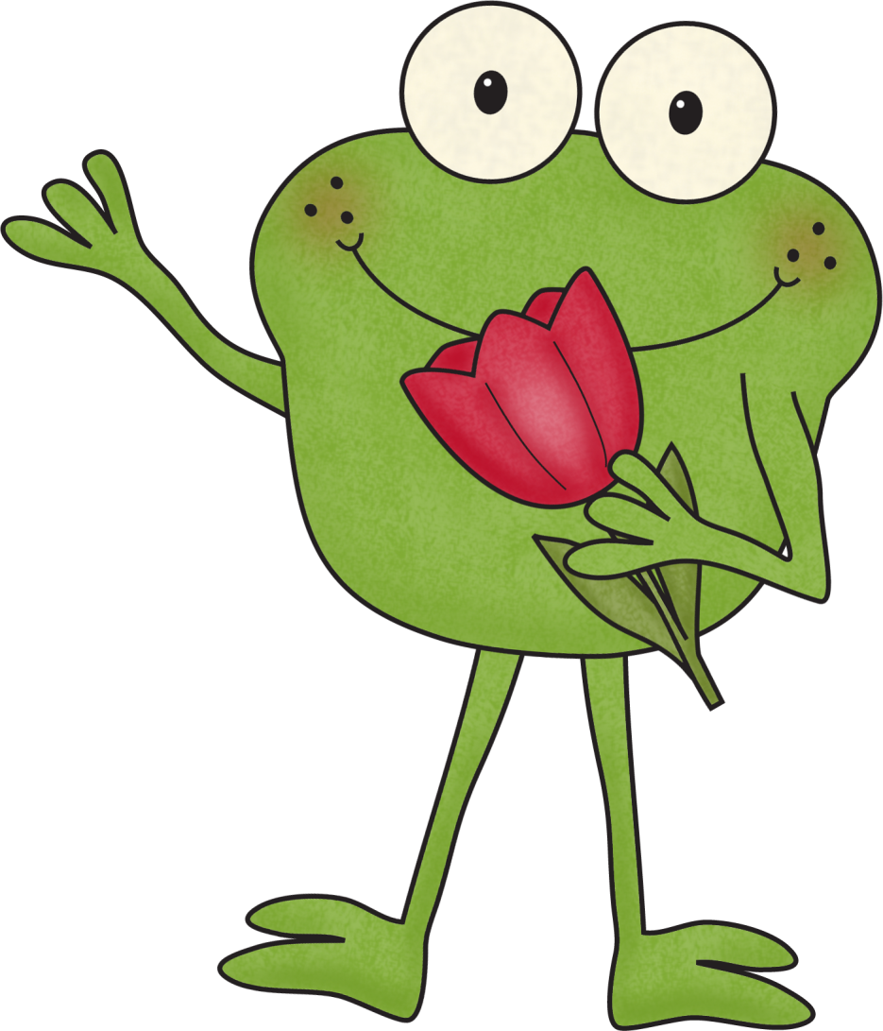
Leanne Williamson, 2015

