Slide 1
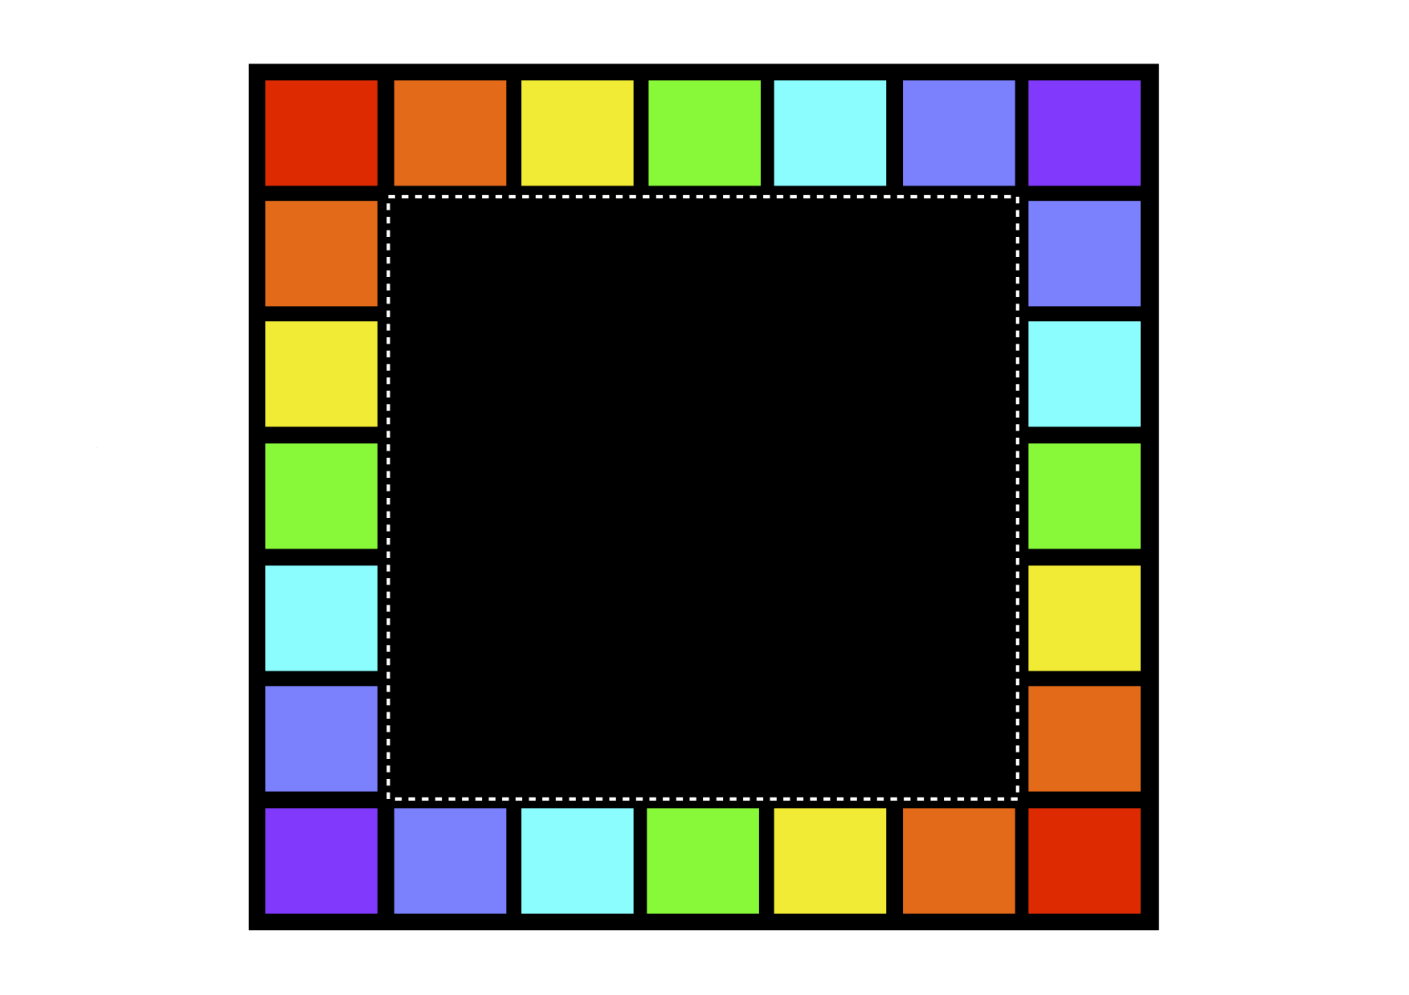
What do you think Wednesday?
You have three minutes to tell me what you think and why.

Slide 2
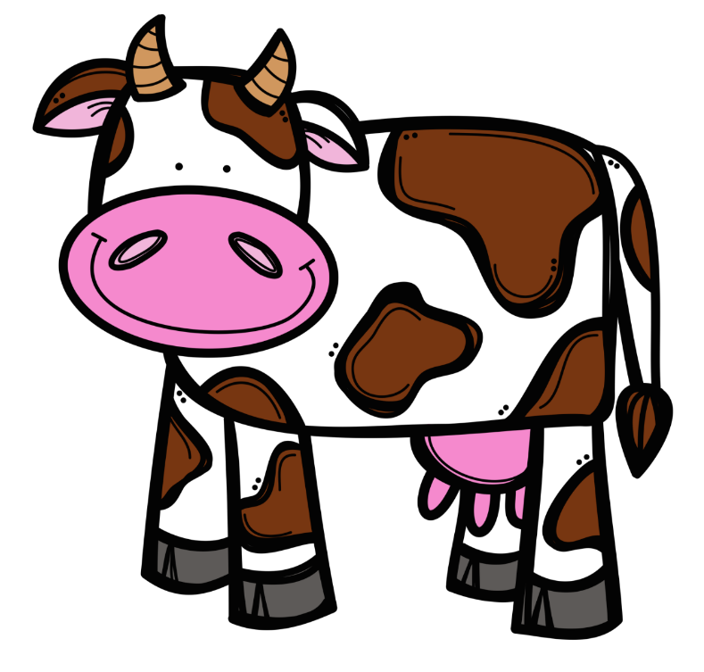
Week 1
Do you like cows or
pigs the
best?
Why?
I like _____ the best because…

Slide 3
Week 2
Do you like McDonalds or KFC the
best?
Why?
I like _____ the best because…

Slide 4
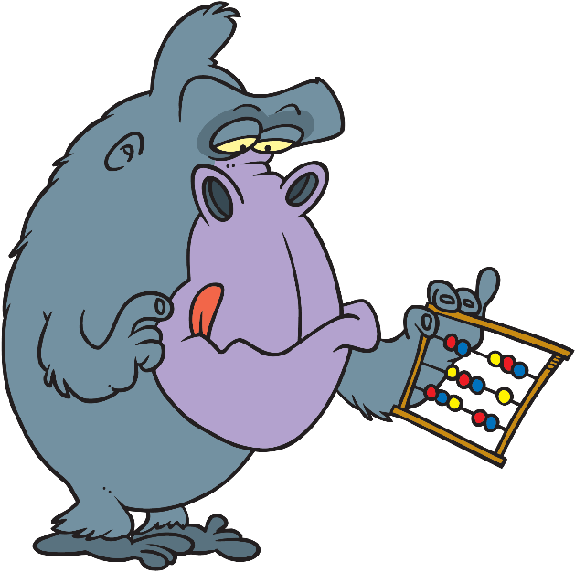
Week 3
Do you like reading or
maths the
best?
Why?
I like _____ the best because…

Slide 5
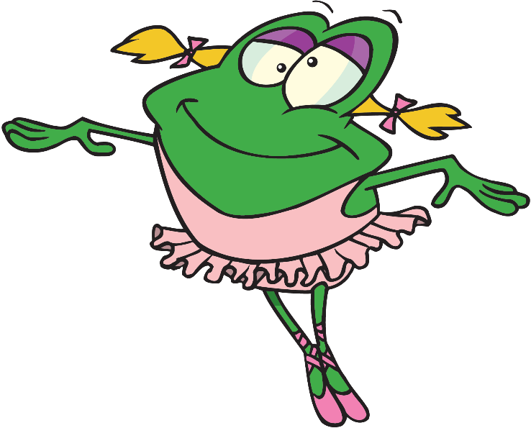
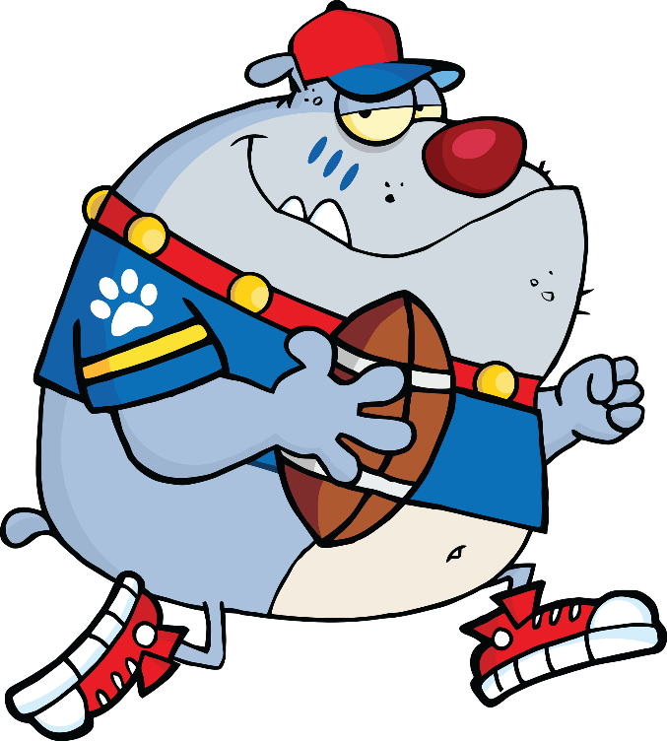
Week 4
Do you like football or
ballet the
best?
Why?
I like _____ the best because…

Slide 6
Week 5
Do you like cake or
ice cream the best?
Why?
I like _____ the best because…

Slide 7
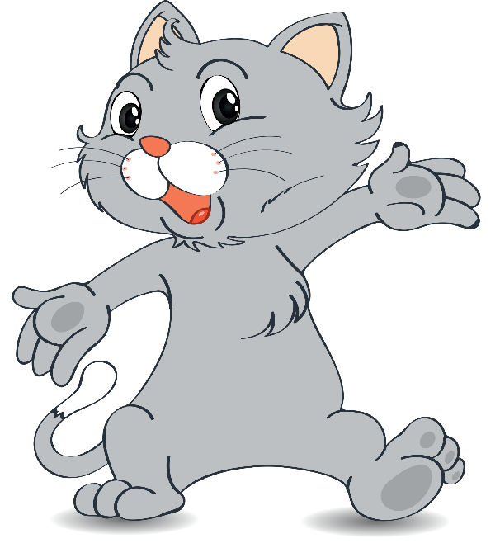
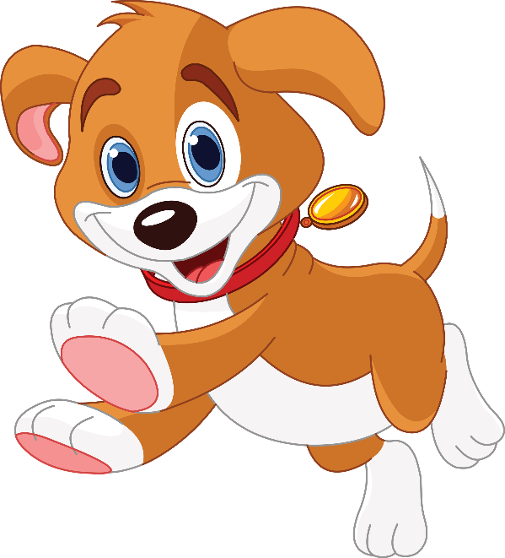
Week 6
Do you like cats or
dogs the
best?
Why?
I like _____ the best because…

Slide 8
Week 7
Do you like day or
night the
best?
Why?
I like _____ the best because…

Slide 9
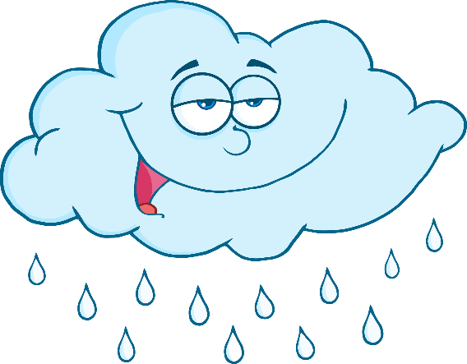
Week 8
Do you like summer or
winter the
best?
Why?
I like _____ the best because…

Slide 10
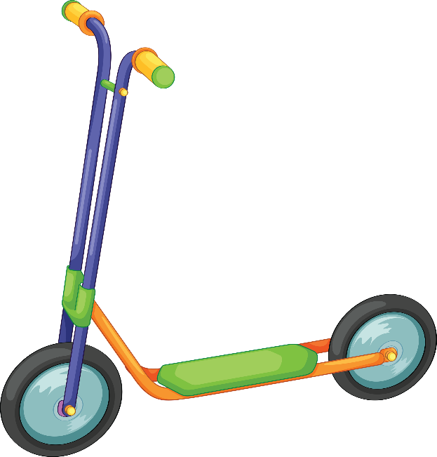
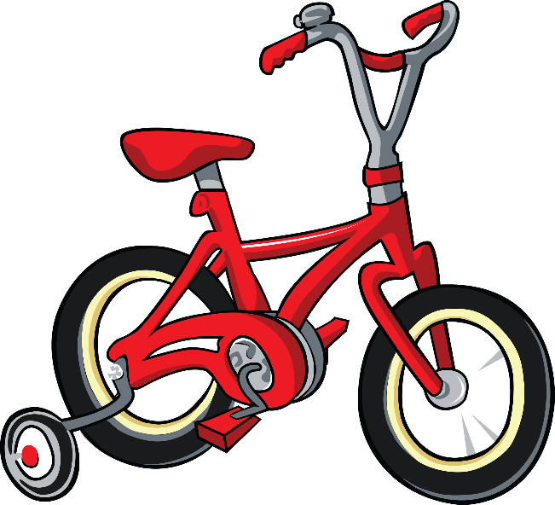
Week 9
Do you like scooters or
bikes the
best?
Why?
I like _____ the best because…

Slide 11
Week 10
Do you like school or
holidays the
best?
Why?
I like _____ the best because…

